Slide 1


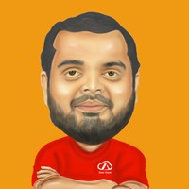


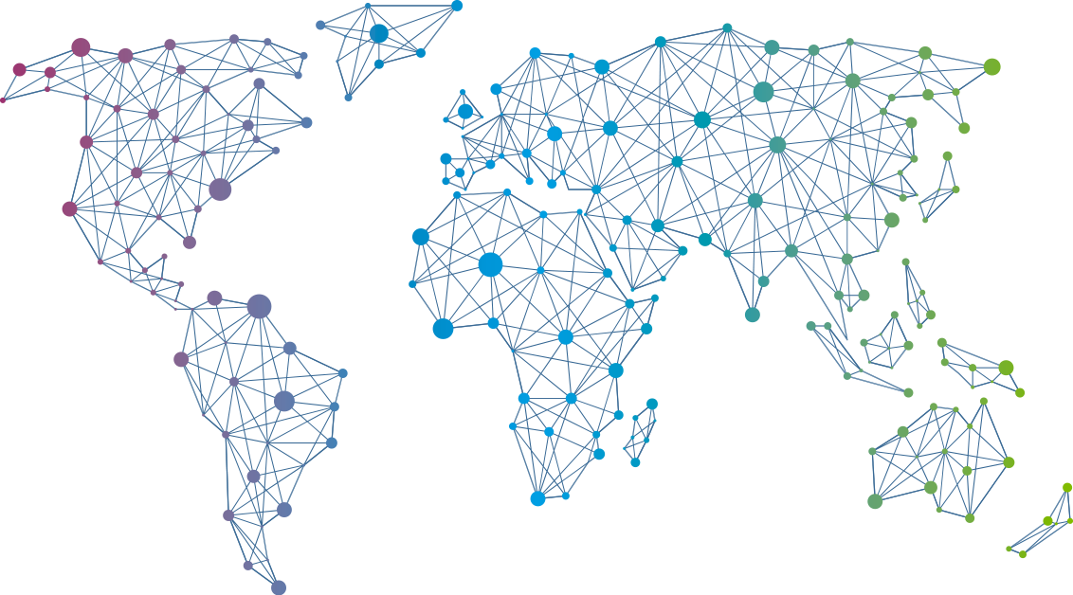

Speaker
Kasam Shaikh
Demystifying Azure AI with Azure IPaaS
Kasam Shaikh
KasamShaikh
September 16th & 17th
^{Online Event}
Powered By
International Conference

